Slide 1
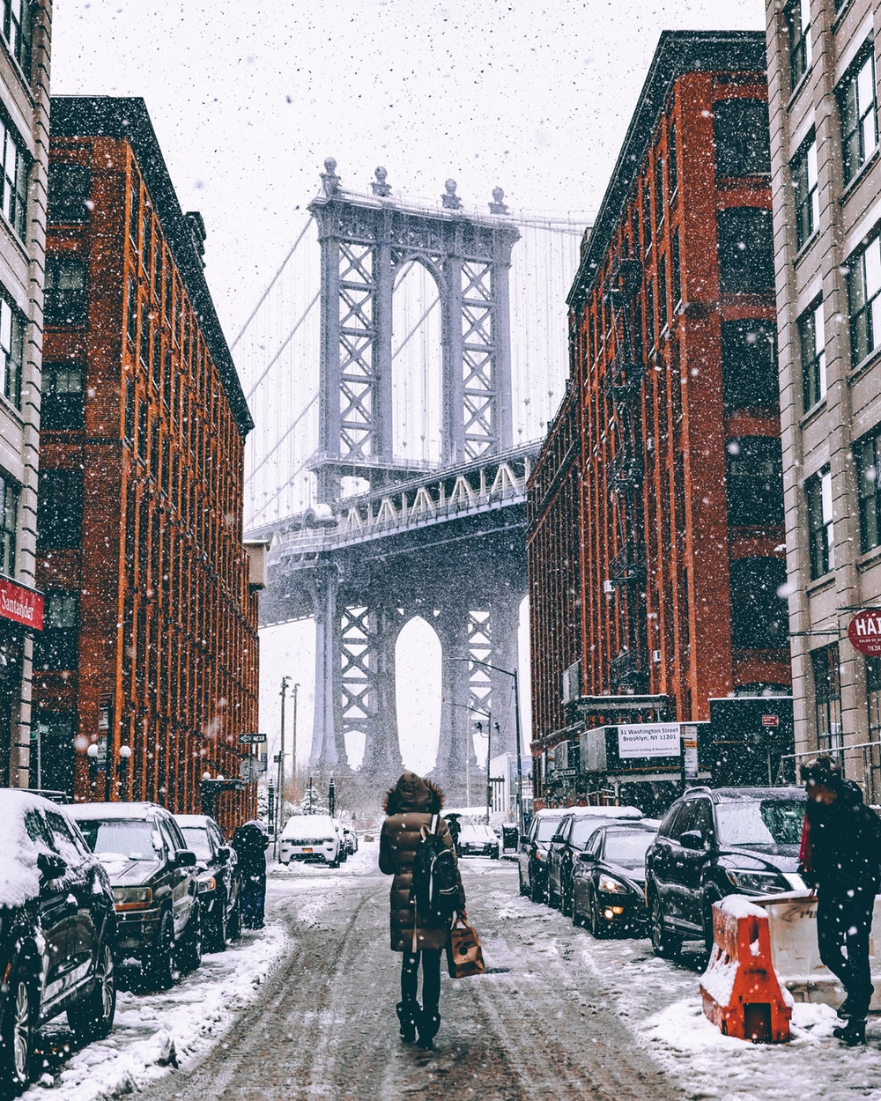

Destitute on Delancey: The John Caudle Story
Based on True Story
Andrey Zelenovsky
Becca Dailey
Charles Laurent
Colin Bayer
John Caudle

Slide 2
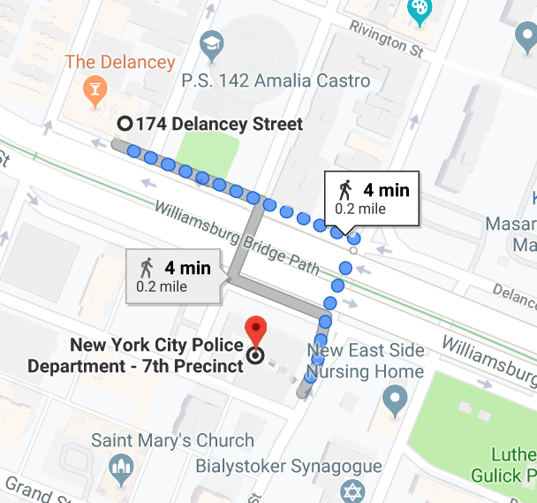
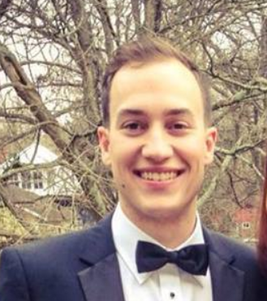
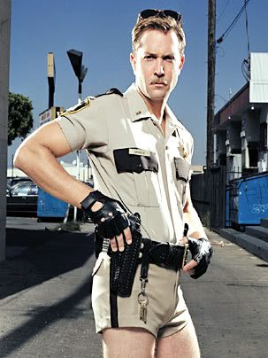

The Victim: John Andrew Caudle
???
???
???
???
???
???

Slide 3
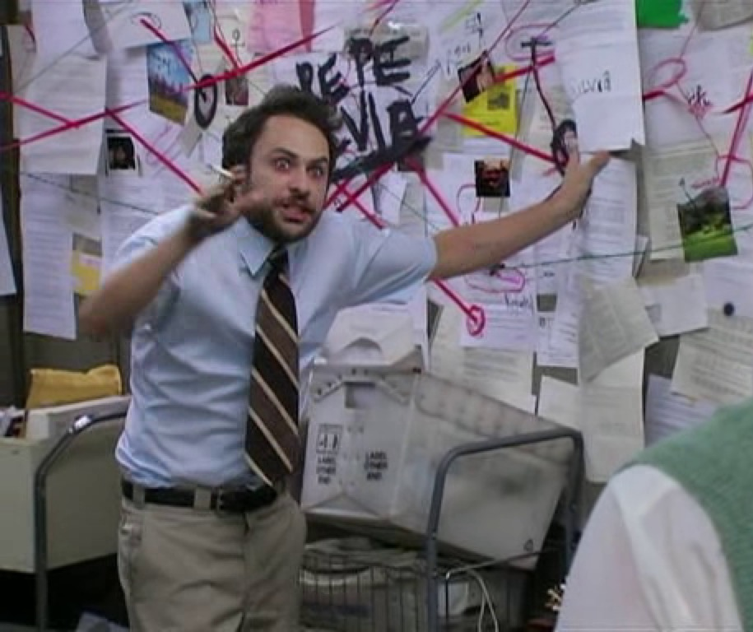
The Investigation Begins
Three Databases:
NYPD Complaints
Daily Weather Reports for NYC
NYC Police Precincts

Slide 4

A Classic Whodunnit
The Potential Culprits:
John’s Super
Inside Job (John’s neighbor)
Hilary (John’s Fiancé)
Professor Panos
Teddy Callahan at 2 AM after Three Sheets
Weather

Slide 5
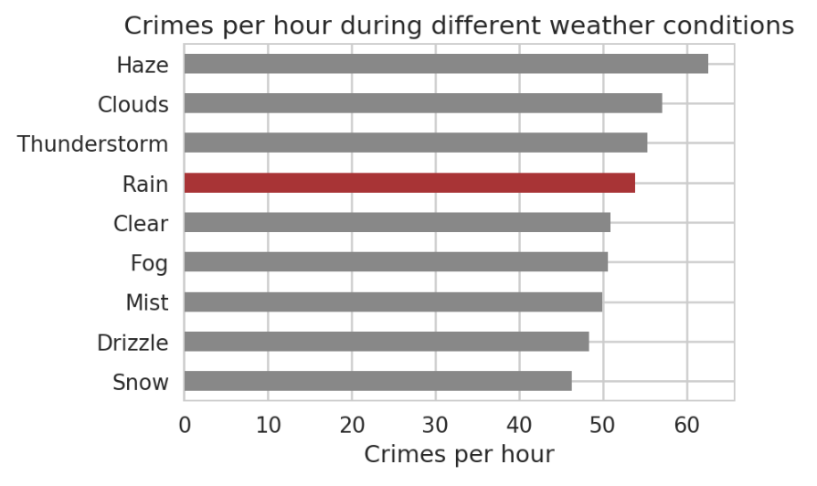
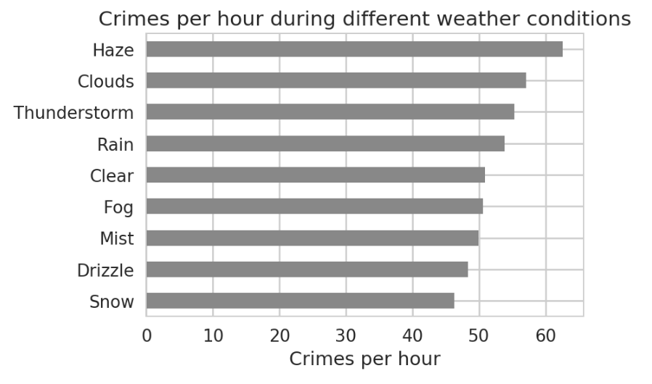
Weather: what does it do to crime rates?

Slide 6
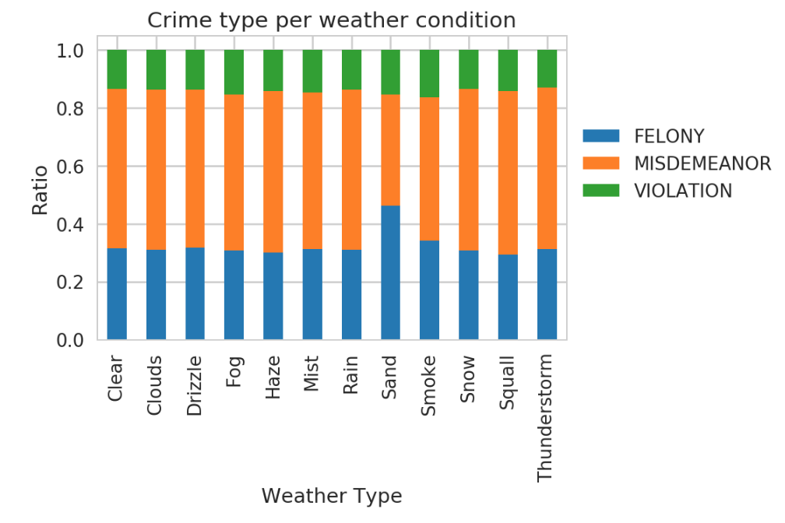
Weather: does it make crimes more severe?
Graph comparing misdemeanors vs. felonies vs. violation

Slide 7
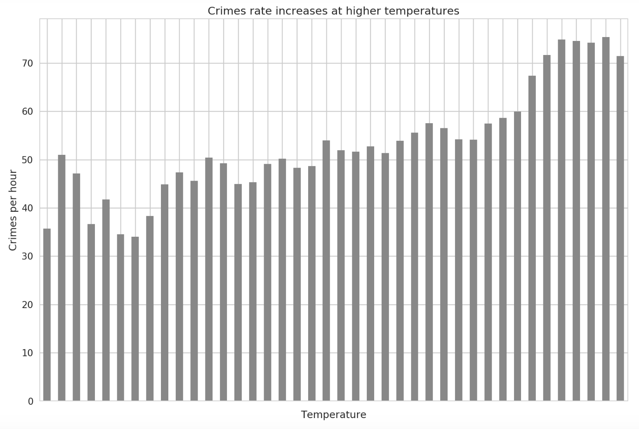
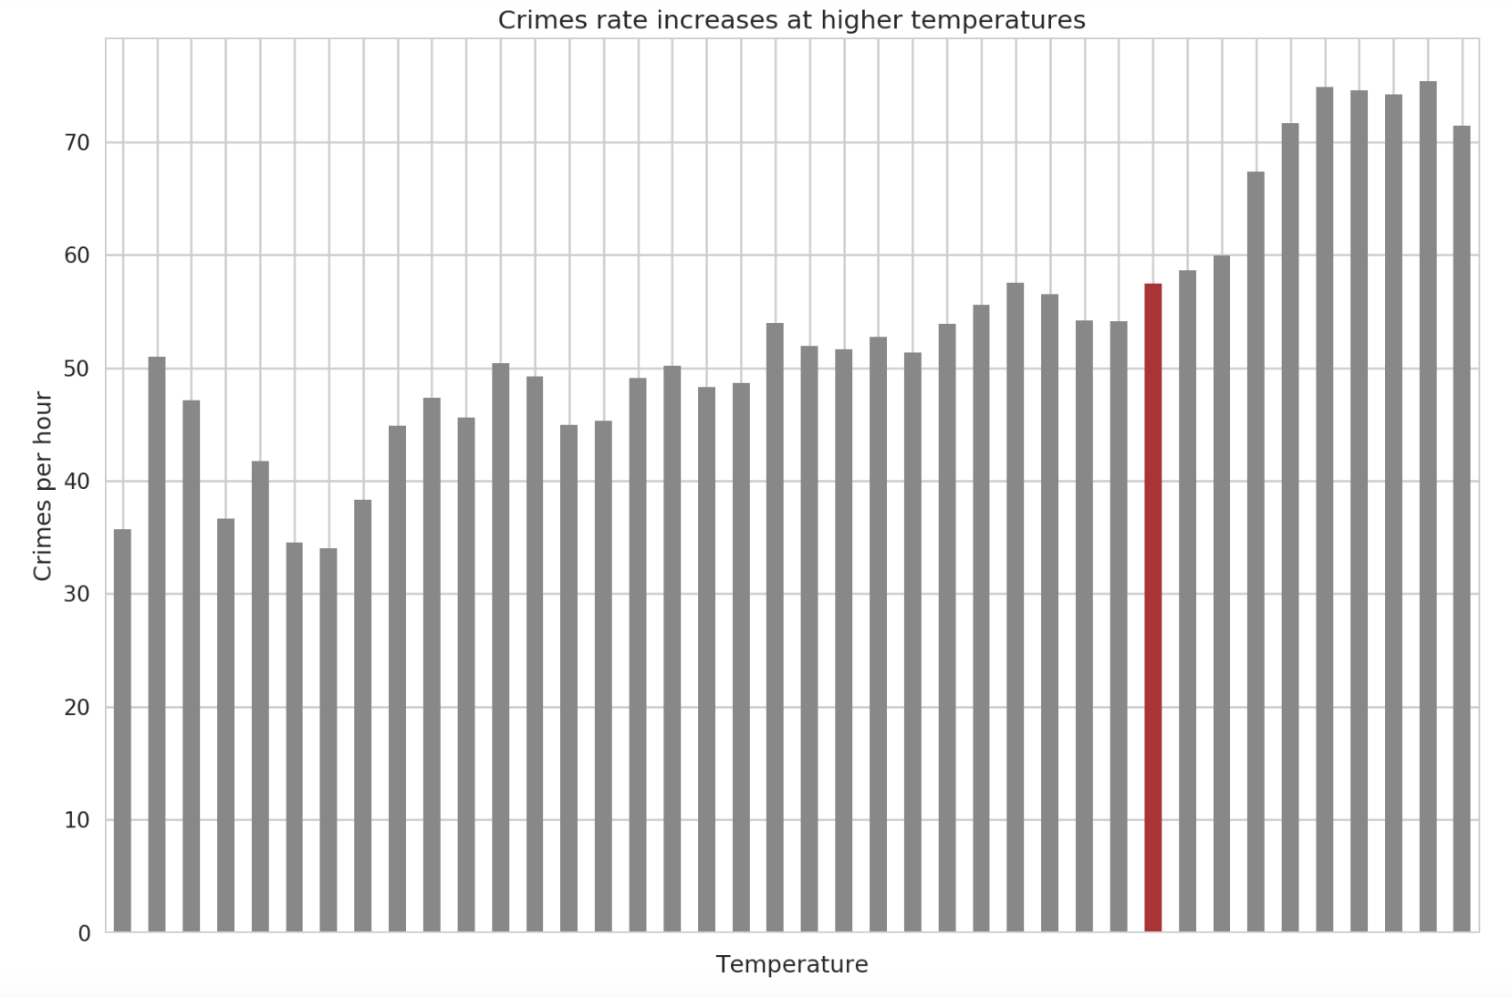
Weather: what if you turn up the heat?
Temperature comparisons of general crime

Slide 8
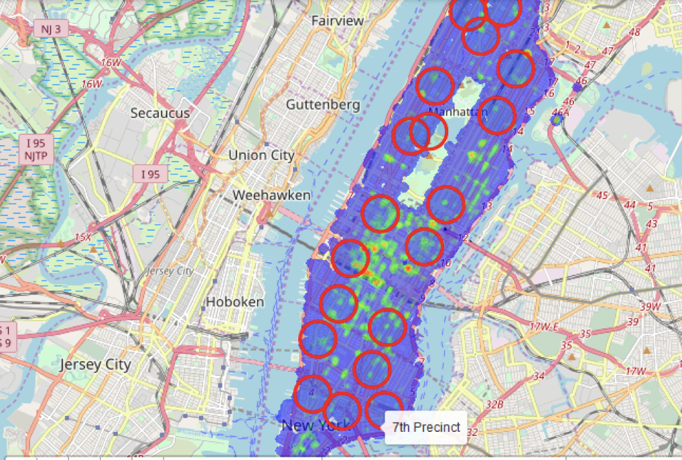
Is this just typical neighborhood crime?

Slide 9
New York’s 7th Precinct

Slide 10
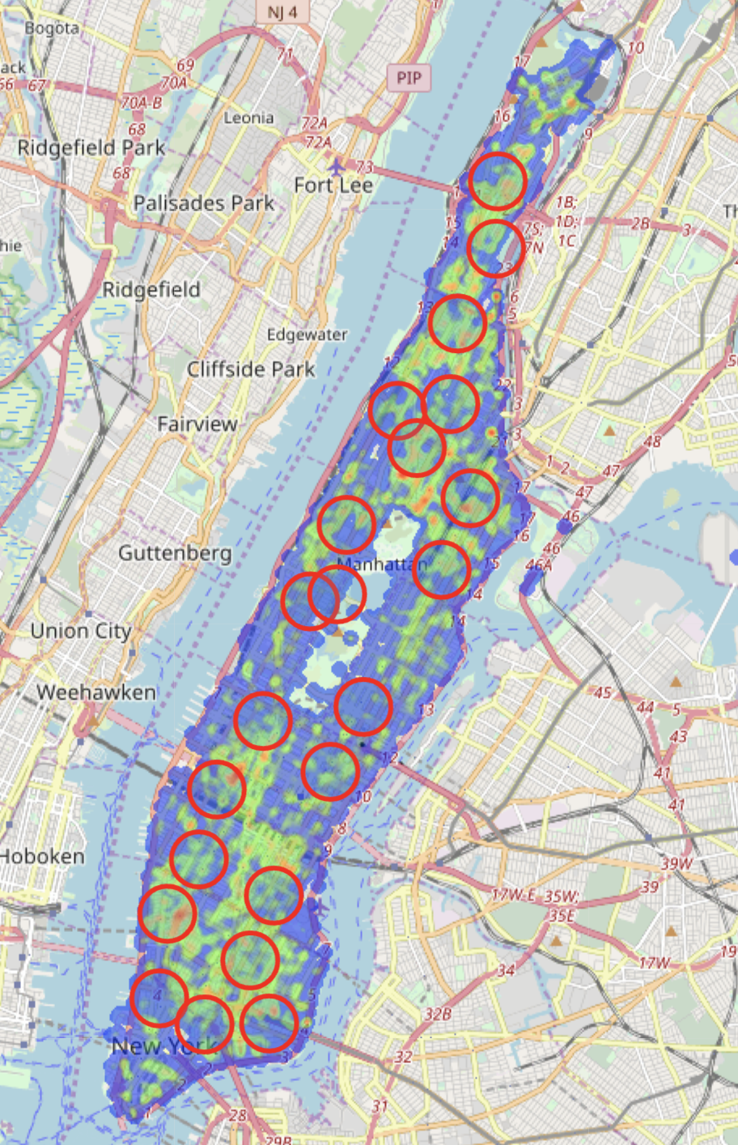
Demo

Slide 11
Conclusions: merely a coincidence?
NYPD Precinct #7 in the LES has high rates of Grand Larceny
More than any other “Big 7” Crimes – merely a coincidence?
Crime rates in Manhattan increase at high temperatures
On average, crime rates are higher during rainy weather
Final Conclusion?

Slide 12

Weather did it!

Slide 13
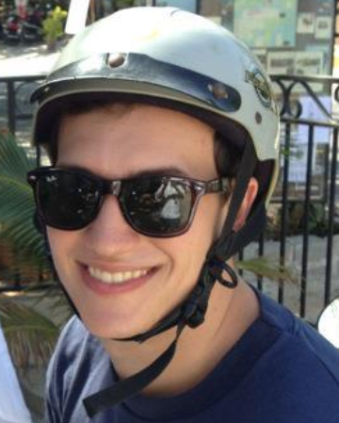
You can help.
For the simple cost of a le creuset pot, you can make a difference.
Support the victims of weather crime by donating items on John’s wedding registry:
http://hilaryandjohn.com/
Don’t let weather win!

Slide 14

Questions?

Slide 15
Appendix

Slide 16
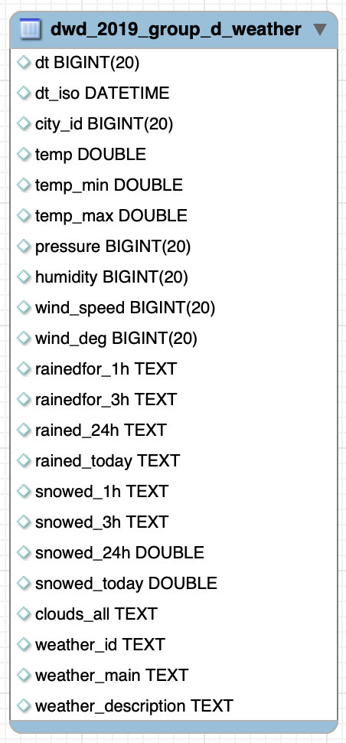
Schema (Weather Data)

Slide 17
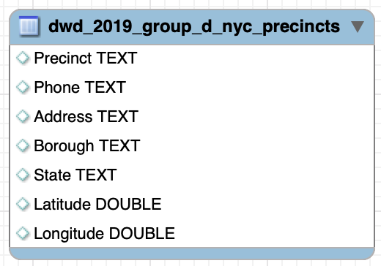
Schema (Precinct Data)

